Slide 1


Computational Intelligence (TC2027)

Slide 2


Slide 3
Unit 4 – Network Security (II)
Network Address Translation (NAT)
Intrusion Detection System
Honeypots

Slide 4
Network Address Translation (NAT)

Slide 5
What is NAT?
Network Address Translation (NAT) is the process where a network device, usually a firewall, assigns a public address to a computer (or group of computers) inside a private network.
The main use of NAT is to limit the number of public IP addresses an organization or company must use, for both economy and security purposes.

Slide 6
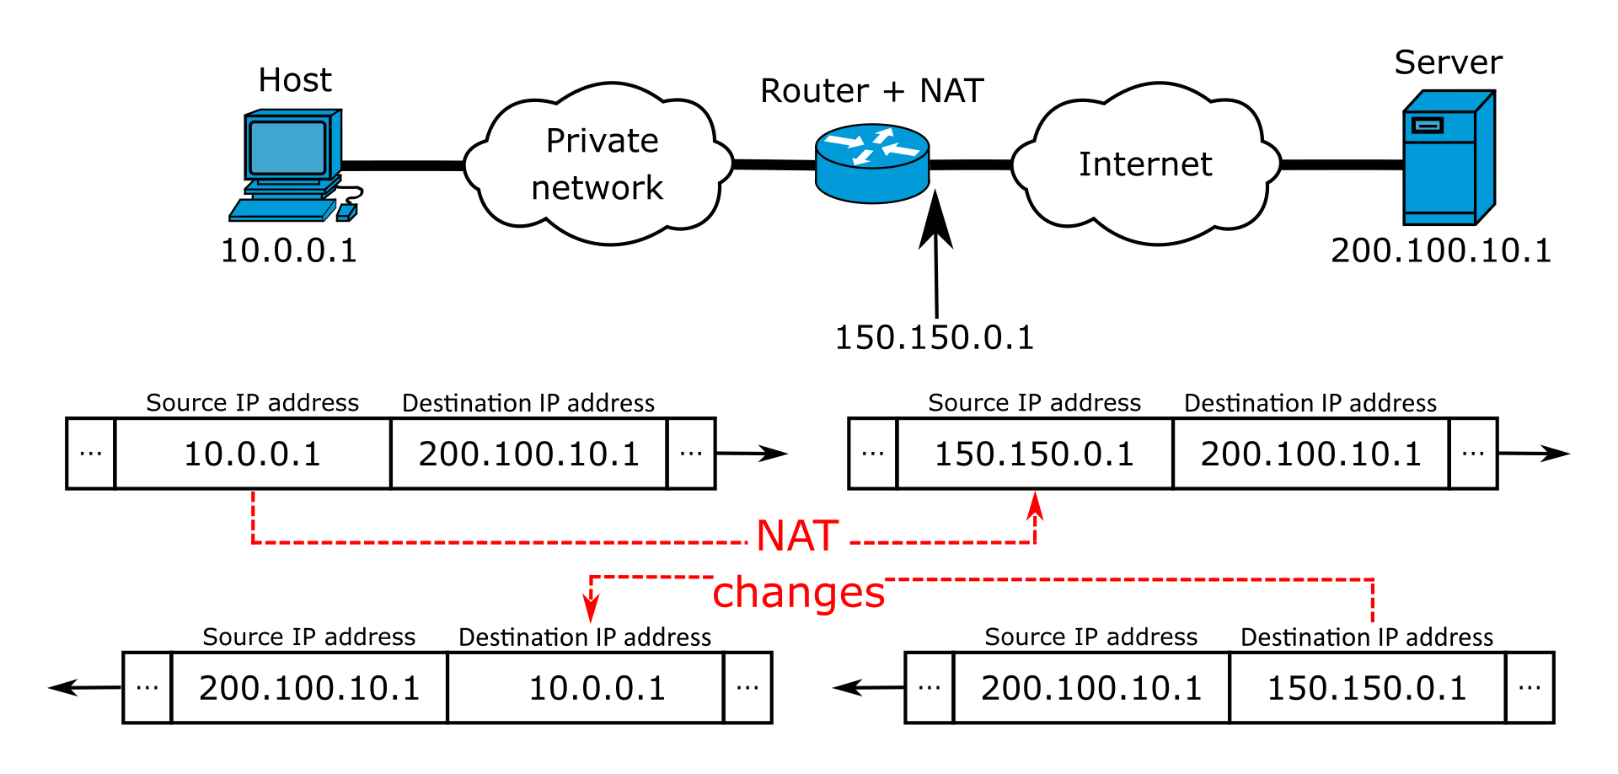
What is NAT?

Slide 7
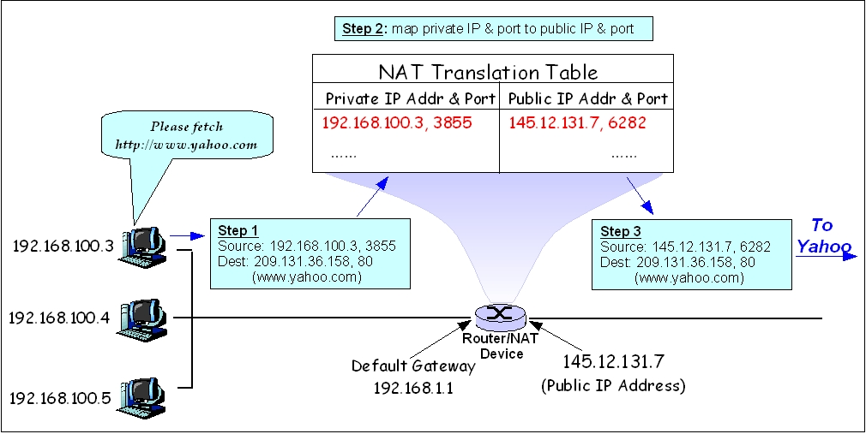
What is NAT?

Slide 8
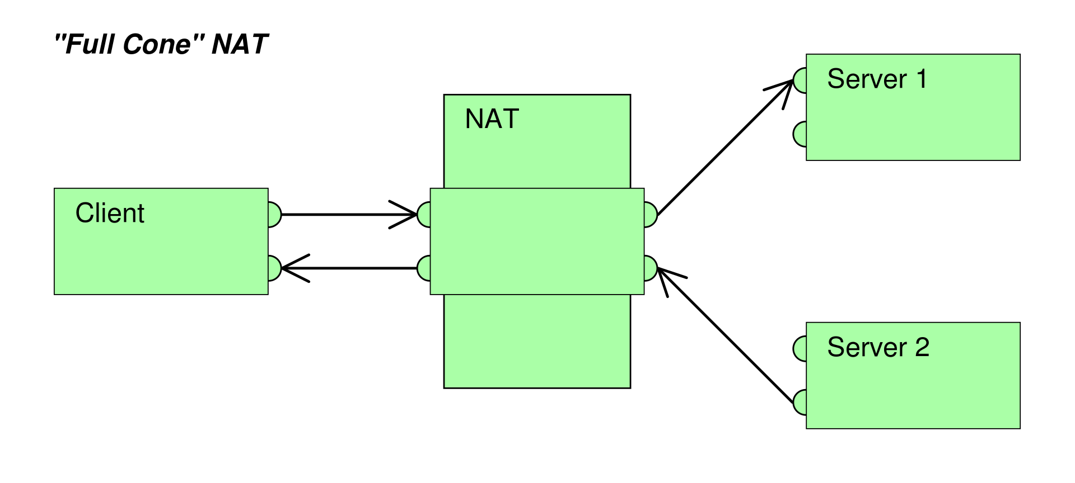

Types of NAT
Full-cone NAT (one-to-one NAT): Once an internal address is mapped to an external address (static).
(Address)-restricted-cone NAT: an internal address is mapped to an external address. An external host can send packets to an internal address, only if the internal address has previously sent a packet using previous port (dynamic open ports).

Slide 9

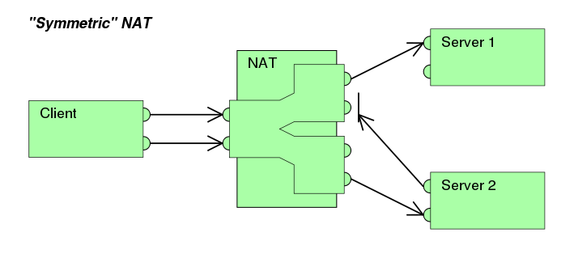
Types of NAT
Port-restricted cone NAT: Like an address restricted cone NAT, but the restriction includes port numbers. To be possible to send packages to an internal address is required that the exploit port is mapped to an external address.
Symmetric NAT: each request from the same internal IP address and port to a specific destination IP address and port is mapped to a unique external source IP address and port.

Slide 10
Intrusion Detection System

Slide 11
What is an Intrusion Detection System?
Defined as the tools, methods, and resources to help identify, assess, and report unauthorized or unapproved network activity.
An IDS detects activity in traffic that may or may not be an intrusion.
IDS’s can detect and deal with insider attacks, as well as, external attacks, and are often very useful in detecting violations of corporate security policy and other internal threats.

Slide 12
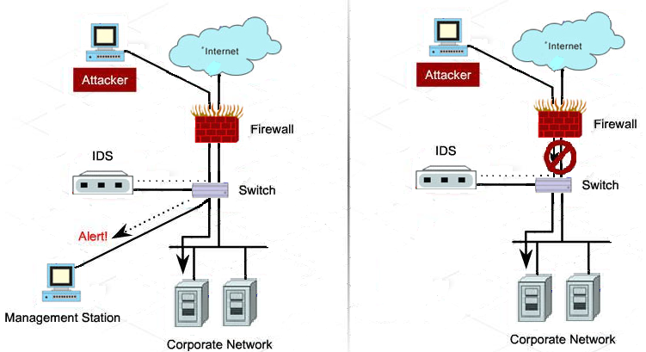
Intrusion Detection System (IDS) x Intrusion Prevention System (IPS)
Provides a Passive Defense
Provides an Active Defense

Slide 13
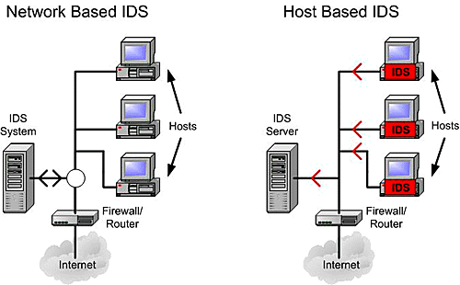
Intrusion Detection System Types
Host Based: usually installed on servers and are more focused on analyzing the specific operating systems and applications, resource utilization and other system activity residing on the Host-based IDS host.
Network Based: it is a dedicated network device distributed within networks that monitor and inspect network traffic flowing through the device.

Slide 14
IDS - Host Based
It will log any activities it discovers to a secure database and check to see whether the events match any malicious event record listed in the knowledge base.
Host-based IDS are often critical in detecting internal attacks directed towards an organization’s servers such as DNS, Mail, and Web Servers.

Slide 15
IDS - Network Based
Instead of analyzing information that originates and resides on a host, Network-based IDS uses packet sniffing techniques to pull data from TCP/IP packets or other protocols that are traveling along the network.
Most Network-based IDS log their activities and report or alarm on questionable events.
Network-based IDS work best when located on the DMZ, on any subnets containing mission critical servers and just inside the firewall.

Slide 16
Comparison
Host Based
Narrow in scope (watches only specific host activities)
More complex setup
Better for detecting attacks from the inside
More expensive to implement
Detection is based on what any single host can record
Does not see packet headers
Usually only responds after a suspicious log entry has been made
OS-specific
Detects local attacks before they hit the network
Verifies success or failure of attacks
Network Based
Broad in scope (watches all network activities)
Easier setup
Better for detecting attacks from the outside
Less expensive to implement
Detection is based on what can be recorded on the entire network
Examines packet headers
Near real-time response
OS-independent
Detects network attacks as payload is analyzed
Detects unsuccessful attack attempts

Slide 17
Hybrid IDS
Are systems that combine both Host-based IDS, which monitors events occurring on the host system and Network-based IDS, which monitors network traffic, functionality on the same security platform.
A Hybrid IDS, can monitor system and application events and verify a file system’s integrity like a Host-based IDS, but only serves to analyze network traffic destined for the device itself.
A Hybrid IDS is often deployed on an organization’s most critical servers.

Slide 18
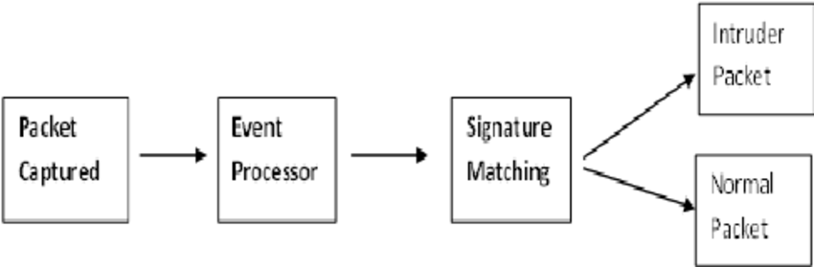
Signature Based IDS
Monitor network or server traffic and match bytes or packet sequences against a set of predetermined attack lists or signatures.
Should a particular intrusion or attack session match a signature configured on the IDS, the system alerts administrators or takes other pre-configured action.

Slide 19
Signature Based IDS
Signatures are easy to develop and understand if you know what network behavior you’re trying to identify.
However, because they only detect known attacks, a signature must be created for every attack.
New vulnerabilities and exploits will not be detected until administrators develop new signatures.
Another drawback to signature-based IDS is that they are very large, and it can be hard to keep up with the pace of fast-moving network traffic.

Slide 20
Anomaly Based IDS
Use network traffic baselines to determine a “normal” state for the network and compare current traffic to that baseline.
Use a type of statistical calculation to determine whether current traffic deviates from “normal” traffic, which is either learned and/or specified by administrators.
If network anomalies occur, the IDS alerts administrators.
A new attack for which a signature doesn’t exist can be detected if it falls out of the “normal” traffic patterns.
High false alarm rates created by inaccurate profiles of “normal” network operations.

Slide 21
IDS Issues
False Negatives
When an IDS fails to detect an attack
False negatives occur when the pattern of traffic is not identified in the signature database, such as new attack patterns.
False negatives are deceptive because you usually have no way of knowing if and when they occurred.
You are most likely to identify false negatives when an attack is successful and wasn’t detected by the IDS.
False Positives
Described as a false alarm.
When an IDS mistakenly reports certain “normal” network activity as malicious.
Administrators have to fine tune the signatures or heuristics in order to prevent this type of problem.

Slide 22
IDS Pros
Can detect external hackers, as well as internal network-based attacks
Scales easily to provide protection for the entire network
Offers centralized management for correlation of distributed attacks
Provides defense in depth
Gives administrators the ability to quantify attacks
Provides an additional layer of protection

Slide 23
IDS Cons
Generates false positives and negatives
Reacts to attacks rather than preventing them
Requires full-time monitoring and highly skilled staff dedicated to interpreting the data
Requires a complex incident response process
Cannot monitor traffic at higher network traffic rates
Generates an enormous amount of data to be analyzed
Cannot deal with encrypted network traffic
It is expensive

Slide 24

IDS & Firewall
Notes:
https://www.youtube.com/watch?v=JXfm92Q_r-8

Slide 25
Honeypots

Slide 26

Notes:
https://www.youtube.com/watch?v=gI8LnMAhBv8&t=1s

Slide 27

Honeypots
Are decoy servers or systems setup to gather information regarding an attacker of intruder into networks or systems.
Appear to run vulnerable services and capture vital information as intruders attempt unauthorized access.
Provide you early warning about new attacks and exploitation trends which allow administrators to successfully configure a behavioral based profile and provide correct tuning of network sensors.
Can capture all keystrokes and any files that might have been used in the intrusion attempt.

Slide 28
Honeypots Types
Production honeypots: serve as decoy systems inside fully operating networks and servers, often as part of an intrusion detection system (IDS). They deflect criminal attention from the real system while analyzing malicious activity to help mitigate vulnerabilities.
Research honeypots: used for educational purposes and security enhancement. They contain trackable data that you can trace when stolen to analyze the attack.

Slide 29
Honeypots Limitations
Honeypot security has its limitations as the honeypot cannot detect security breaches in legitimate systems, and it does not always identify the attacker.
There is also a risk that, having successfully exploited the honeypot, an attacker can move laterally to infiltrate the real production network. To prevent this, you need to ensure that the honeypot is adequately isolated.

Slide 30
Unit 4 – Network Security (II)
Network Address Translation (NAT)
Intrusion Detection System
Honeypots

Slide 31
Computational Intelligence (TC2027)

